Slide 1
Unit D
4.1 Meaning, Job analysis
4.2 Manpower planning, Sources of Recruitment, factors affecting recruitment , Transfers and Promotions
4.3 Introducing concepts of Performance Appraisals, Management Development, Job Rotation, Training, Rewards and Recognition, Cross cultural management

Slide 2
QUESTIONS TO ANSWER
What is the importance of doing HRP? Outline its process.
How job analysis is done? What are the outcomes of job analysis? Illustrate with the help of an example.
Does recruitment differs from selection? Explain the various sources of recruitment in detail.
Elaborate the selection process in detail. What are the different types of selection tests?
Short notes: Induction and placement.

Slide 3
QUESTIONS TO ANSWER
What is the importance of doing HRP? Outline its process.
How job analysis is done? What are the outcomes of job analysis? Illustrate with the help of an example.
Does recruitment differs from selection? Explain the various sources of recruitment in detail.
Elaborate the selection process in detail. What are the different types of selection tests?

Slide 4
HR Planning Issues
Staffing Questions:
How do we manage staffing in times of recession or expansion?
What impact does technology change, mergers or relocation have on staffing issues?
Do we always have the right people in the right jobs at the right time?
How do we get our human resources: buy them or make them or both?

Slide 5
Major Objectives of HRP
Preventing understaffing and overstaffing.
Ensure the organisation has the right employees with the right skills at the right place at the right time.
Ensure the organisation is responsive to changes in its environment.
Provide direction and coherence to all HR activities and systems.

Slide 6
INTRODUCTION
The success of an organisation depends largely on the quantity and quality of its human resources.

Slide 7
Human Resource Planning
Vetter has defined HRP as “the process by which management determines how an organization should move from its current manpower position to its desired manpower position”

Slide 8
In the words of Stainer, “Manpower planning is the strategy for acquisition, utilization, improvement and preservation of an organization’s human resources. It is aimed at coordinating the requirements for and the availability of different types of employees. ”

Slide 9
HRP / MPP
Making an inventory of present manpower resources and assessing how these resources are utilized.
In the words of Stainer, “Manpower planning is the strategy for acquisition, utilization, improvement and preservation of an organization’s human resources. It is aimed at coordinating the requirements for and the availability of different types of employees.”

Slide 10
Human Resource Planning helps in anticipating manpower problems and determines their adequacy quantitatively and qualitatively in:
Recruitment
Selection
Training and Development
Transfer and promotion
compensation

Slide 11
It includes the estimation of how many people are necessary to carry out the assigned activities, how many people will be available and ensures that personnel supply equals Personnel demand

Slide 12
Importance of HRP
Future Personnel needs
Coping with changes
Creating highly talented Personnel
Foundation for personnel function
To ensure optimum utilization of existing hr
Part of Strategic Planning

Slide 13
HR Planning Issues
Staffing Questions:
How do we manage staffing in times of recession or expansion?
What impact does technology change, mergers or relocation have on staffing issues?
Do we always have the right people in the right jobs at the right time?
How do we get our human resources: buy them or make them or both?

Slide 14
Importance of HRP
Future Personnel needs
Coping with changes
Creating highly talented Personnel
Protection of weaker sections
Foundation for personnel function
To ensure optimum utilization of existing hr
Part of Strategic Planning

Slide 15
Business Vision and
Strategy
External forces
requiring restructuring
Technological
change
Stakeholder
expectations
CAPABILITIES
NEEDED
CONTINUITY
PLAN
BUILDING FOR
THE FUTURE
Manpower
flows

Slide 16
Needs of
the
organisation
Needs of
the
individual
fair rewards
challenging work
good working environment
information
feedback
meeting career aspirations
providing transferable skills
continuity and growth
of human capital
performance
potential
flexibility
commitment
retention
innovation

Slide 17
THE PLANNING PROCESS
Environmental scanning
Analysis of external forces like socio-economic changes,
demographic changes, technological changes, government
policies, political situation
Organizational objectives and policies
Organizational objectives determine objectives of HR plan
Are vacancies to be filled through promotions?
How to implement downsizing plan?
How to ensure availability of adaptive and flexible work environment

Slide 18
HRP Process
Organisational Objectives and policies
HR need Forecast
HR Supply Forecast
HR Programming
HRP Implementation
SURPLUS
Control and Evaluation
Shortage
Restricted hiring, restricted hours, VRS,Lay offs
Recruitment and Selection

Slide 19
Human Resource Planning Process
It involves forecasting Personnel needs, assessing Personnel supply and matching demand supply factors through personnel related Programmes.
Organisational Objectives and policies:

Slide 20
HR Demand Forecast:It is the process of estimating the future quantity and quality of people required.
For eg: In a manufacturing firm, a production plan determines the no. and types of products to be producedin each period.From this information no.of working hours by each skilled personnel can be calculated, once the hours are available the quality and quantiity of personnel required can be forecasted.
Human resources need forecasts to anticipate hiring needs.
Process of predicting a future event based on historical data
Educated Guessing

Slide 21
1. Benefits of HR Forecasting
1. Prevent understaffing and disruption to operations.
2. Prevent overstaffing and subsequent costs of employee layoff.
3. Allow efficient and effective use of other HR functions.

Slide 22
HR Demand Forecast
  The process of estimating organization's quantity and quality
of future workforce
  In manufacturing concern estimated sale volume converted
into production plan that gives idea of working hours/number
of workers
  HR demand forecast must consider both internal (budget
constraints, production level, new products and services,
employment policy etc.) and external factors (local and global
competition, economy, political and legal conditions etc.)
HR demand forecast help to
1) quantify the jobs required to produce number of goods or
offering service 2) identify desirable staff mix 3) determine
appropriate level of staff in each department 4) prevent
shortages 5) monitor compliance

Slide 23
TECHNIQUES OF HR DEMAND FORECASTING
Management Judgment
Ratio Trend Analysis
Work Study Techniques
HR DEMAND FORECASTING TECHNIQUES
Others
Flow Models
Delphi Technique

Slide 24
Managerial Judgment- managers sit together, discuss, and arrive at a figure which would be the future demand for labour.
2. Ratio-trend Analysis- the technique involves studying past ratios like between the number of workers and sales in an organisation and forecasting future ratios

Slide 25
  3. Trend Analysis
Method which forecast employments requirements on the basis of some organizational index and is one of the most commonly used approaches for projecting HR demand.
Business Factor Annual Volume of Sales.
Total Number of Employees.
Compare the Productivity Ratio.

Slide 26
4. Study Technique
Work study technique is based on the volume operation and work efficiency of personnel. Volume of operation is derived from the organizational plan documents and increase/decrease in operation can be measured.
Planned output
Standard output per hour x standard hours per person

Slide 27
Workforce Study Techniques
Calculation of amount of labour required by determining length of operations and units of production
Planned output for next year 20,000 unit
Standard hours per unit 5
Planned hours for the year 100,000
Productive hours per man 2,000
(allowing normal overtime, absenteeism and idle time)
Number of direct labour required 50

Slide 28
  5. Delphi Technique
This technique calls for a facilitator to solicit and collate written, expert opinion on labor forecast. After answer are received, a summary of the information is developed and distributed to the expert, who are than requested to submit revised forecast. Expert never meet face-to-face, but rather communicate through the facilitator.

Slide 29

  6. Regression Analysis
Regression analysis identifies the movement of two or more inter-related series. It is used to measure the changes in a variable as a result of changes in other variables. Regression analysis determines the relationship between Y variables such as the number of employees and X variables such as service delivery by actually measuring the relationship that existed in the past. Use of the method begins with a series of observation each costing of a value for the Y variable plus a value for each X variable.

Slide 30
  7. Nominal Group Technique
The nominal group technique is a decision making method for use among groups of many sizes, who want to make their decision quickly, as by a vote, but want everyone’s opinions taken into traditional voting.
Introduction and Explanation
Silent Generation of Ideas
Sharing Ideas
Group Discussion
Voting and Ranking

Slide 31
8. New Venture Analysis
Useful for new business ventures
Estimating HR needs based on analysis of existing companies in same business
  For example: Company starting coal mine operation can predict future personnel needs by analyzing the workforce demand of companies operating in industry

Slide 32
9. Flow Models
The simplest one is Markov model.
Determine the time that should be covered.
Establish categories, also called states, to which employees can be assigned.
Count annual movements (flows) among states for several time periods.
Estimate the probability of transition from one state to another.

Slide 33
Markov analysis
To help predict internal employee movement from one year to another by identifying percentages of employees who remain in their jobs, get promoted or demoted, transfer, and exit out of the organization.
By tracking and predicting employment movement within an organization, the Markov analysis allows for the development of a transition matrix to forecast internal labour supply.

Slide 34
Markov analysis
Markov Analysis is the statistical technique used in forecasting the future behavior of a variable or system whose current state or behavior does not depend on its state or behavior at any time in the past in other words, it is random.
The technique is named after Russian mathematician Andrei Andreyevich Markov.

Slide 35
Markov analysis
A transition matrix, or Markov matrix, can be used to model the internal flow of human resources.
These matrices simply show as probabilities the average rate of historical movement from one job to another.
To determine the probabilities of job incumbents remaining in their jobs for the forecasting period.

Slide 36
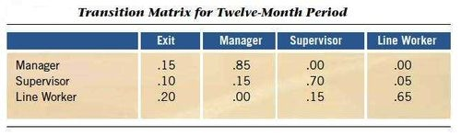
For a line worker, for example, there is a 20% probability of being gone in 12 months, a 0% probability of promotion to manager, a 15% probability of promotion to supervisor, and a 65% probability of being a line worker this time next year. Such transition matrices form the bases for computer simulations of the internal flow of people through a large organization over time.

Slide 37
Forecasting During the Life Cycle
Introduction
Growth
Maturity
Decline
Qualitative models
Quantitative models
- Executive judgment
- Market research
Survey of sales force
Delphi method
- Time series analysis
- Regression analysis
Sales
Time

Slide 38
HR Supply Forecast
After determining the demand forecast, supply forecasting is to be done to determine the procedure and sources that how these requirements can be met. ie.the no. of people likely to be available from within and outside the organisation after considering the factors like:
No of absenteeism
Promotion/Transfers
There are two main sources of supply of Human Resources:
Internal source and External source
Inside the organisation, Promotion , transfer, refrences
Campus, consultants, competitors, unsoliceted applications

Slide 39
HR SUPPLY FORECAST
After demand forecast, next step is to consider the availability and ability to procure the required number of workers/employees
In supply forecast availability of kind and number of workers from both inside and outside sources are measured
In benefits of supply forecast are
  1) prevent shortages of employees
  2) assess existing staffing level
  3) clarify staff mixes for future
  4) quantify the positions and people available in future

Slide 40
HR SUPPLY FORECAST
Human Resource inventory is maintained which provide information about managers (managment inventory) and non managers (skill inventory) and used for making transfer and promotion decisions

Slide 41
The information included in skill inventories are
1) Personal data: Age, gender, marital status
2) Skills: Education level, job experience, training
3) Special Qualification: Professional bodies membership, achievements
4) Salary and Job history: various job held, past and present pay
5) Company date: retirement date and seniority
6) Capacity of individual: health status, scores on psychological, physical test, and IQ test
7) Special preference of individual: geographic location, type of job

Slide 42
MANAGEMENT INVENTORIES
The information on management inventories include following details
Work history
Strength
Weakness
Promotion potential
Career goals
Personal data
Number and type of employee supervised
Total budget managed
Previous management duties

Slide 43
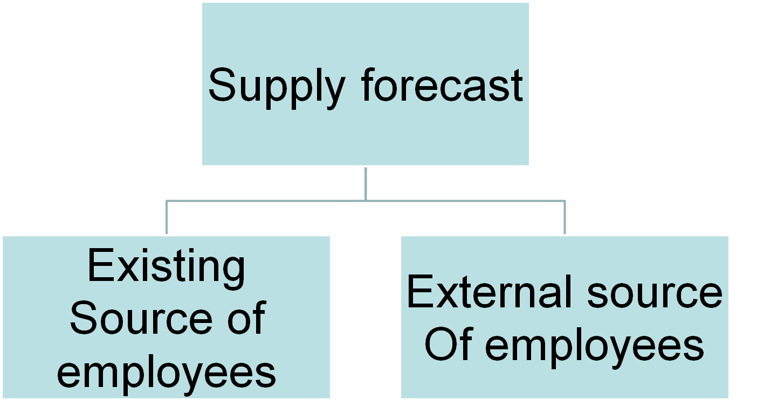

Slide 44
Existing Human Resources – analysis of present employees is done by HR audits. the audits of non managers (skill inventories), and those of management (management inventories).

Slide 45
Internal sources of supply – the techniques used are:
Inflows and Outflows
Sources of inflows are transfers and promotions, and the sources of outflows are resignation, discharge, demotion, retirement, and promotion.

Slide 46
b) Turnover rate – turnover rate is the traditional and simple method of forecasting internal supply.
No. of separations during 1 year
Average no. of employees during the year
c) Conditions of work and absenteeism – changes in conditions of work as weekly working hours,.
X 100

Slide 47
d) Productivity level – any change in productivity would affect the number of persons required per unit of output.
e) Movement among jobs – some jobs are sources of personnel for other jobs in way of promotions and upward movements.

Slide 48
3. External Supply –the reasons are –
new blood and new experience,
organizational personnel need,
growth and diversification

Slide 49
INTERNAL SUPPLY
Estimation of Internal Supply of Computer Programmer
Sources of Inflows | No. of People | Current Personnel level | Sources of Outflows | No. of People
Transfer | 12 |  | Resignations | 13
Promotions | 10 |  | Discharges | 2
 |  | Current Personnel level 250 | Demotions | 4
 |  |  | Retirements | 10
 |  |  | Promotions | 13
Total inflow | 22 |  | Total outflow | 42
250-42+22=230
Adopted from Aswathappa, 2008, p. 92

Slide 50
Replacement chart
A chart used to estimate vacancies in higher level jobs and identify how potential HR supply can fill these vacancies via internal movements from lower levels jobs
Replacement charts provide identification of potential replacements for vacancies within an organization

Slide 51
Replacement chart
A comprehensive replacement chart will include information regarding possible replacements for vertical or horizontal movement.
Generally, a replacement chart includes information about employees’ performance, readiness to fill the position, and education.

Slide 52
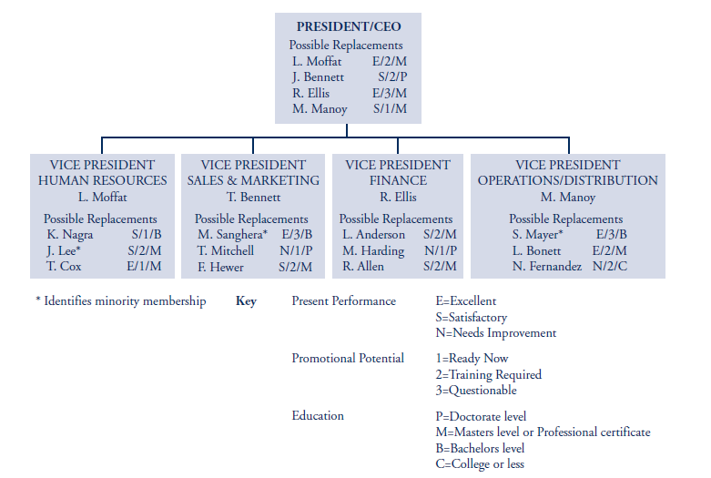
Replacement chart

Slide 53
Succession Planning
Succession planning is a longer-term process of grooming a successor (selected from a pool of candidates on the basis of perceived competency) for management or critical positions.

Slide 54
Succession Planning
Determining the internal labour supply calls for a detailed analysis of how many people are currently in various job categories or have specific skills within the organization.
The planner then modifies this analysis to reflect changes expected in the near future as a result of retirements, promotions, transfers, voluntary turnover, and terminations.

Slide 55
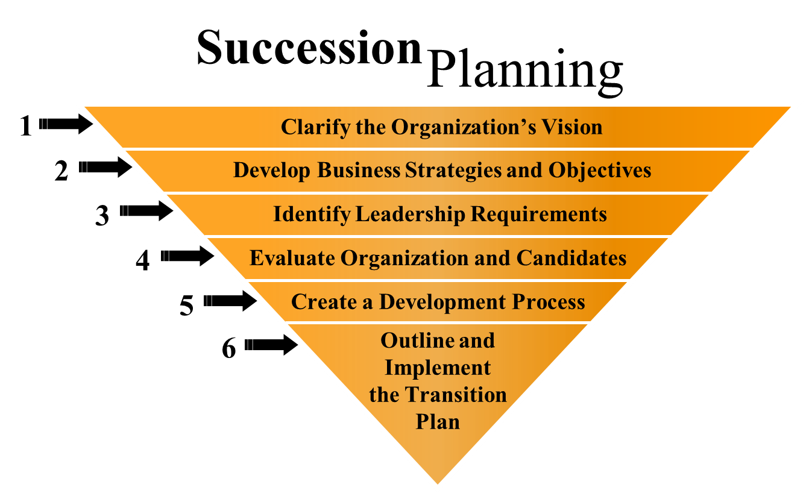

Slide 56
HR Programming
It is the functioning part of the combination of both HR demand forcast and HR supply
HR Programming = (HR Demand + HR Supply)Functioning.

Slide 57
HR Plan Implementation –
converting an HR plan into action.
Recruitment, Selection, Placement
Training and Development
Retraining
Retention Plan
Succession Plan
Control and Evaluation –
The HR plan should include budgets, targets and standards.

Slide 58
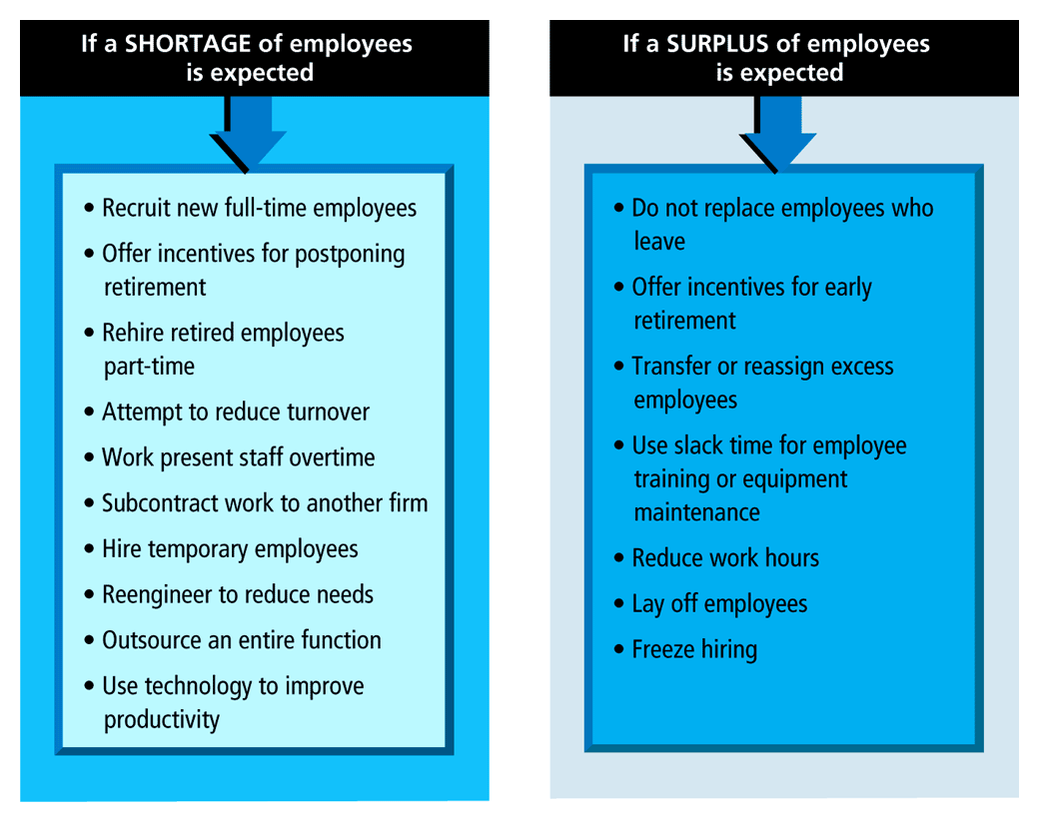

Slide 59
JOB ANALYSIS
Job analysis is a formal and detailed study of jobs.
Job analysis has defined as, “the process of determining by observation and study the tasks, which comprise the job, the methods and equipment used, and the skills and attitudes required for successful performance of the job.”

Slide 60
Job Analysis is a process of studying and collecting the information relating to the operations and responsibilities of a specific job.

Slide 61
It provides the following Information:
Job Identification :Title , Code No.
Characteristics of Job
Materials and Equipments required
Personal attributes required: Education,training
It is useful in HRP, Recruitment, Selection, Training and Development, Organisation audit, Job Evaluation, Job Design, Performance Appraisal

Slide 62
PROCESSOF JOB ANALYSIS
Organizational Analysis
a. Organizational charts.
b. Class specifications.
c. Work flows charts
Organizing Job Analysis Programme
Deciding uses of JA information
Techniques of Job Information
a. Direct observation
b. Interviews.
c. Questionnaire.
d. Past records.
e. Critical Incident
Resposibility for collecting information
a. External Expert
b. Internal Expert
Selecting the Representative Jobs
a. Number of jobs to be analyzed.
b. Priority of different jobs.
Job Description
Job Specification

Slide 63
Organisational Analysis:
An overall view of various jobs in the organisation is obtained.
Organizing Job Analysis Programme

Slide 64
Deciding uses of JA information
Selecting the Representative Jobs:
It would be highly time consuming and costly to analyse all jobs. Therefore it is desirable to select a representative sample of jobs for detailed analysis

Slide 65
Resposibility for collecting information
External Expert
Internal Expert
Techniques of Job Information
a. Direct observation
b. Interviews.
c. Questionnaire.
d. Past records.
e. Critical Incident

Slide 66
Job Description :
It is an organised factual statement of duties and responsibilities of a specific job
Job Specification:
It is a statement of minimum acceptable human qualities necessary to perform a job properly.
It is the key qualifications necessary for someone to perform the job satisfactorily. Education, skills, personality, mental and physical requirements.

Slide 67
Job Analysis
Job description
A statement containing items
Such as
Job title
Location
Job summary
Duties
Machines, tools, equipments
Materials and forms used
Supervision given/received
Working conditions
hazards
job specification
A statement of human qualifications
Necessary to do the job.
Education
Experience
Training
Judgment
Initiative
Physical effort
Responsibilities
Communication skills
Emotional characteristics
Sensory demands such as sight,
smell, hearing
Behavioral skills

Slide 68
Job Analysis
Human Resource Planning
Recruitment
Selection
Training and Development
Performance Appraisal
Compensation and Benefits
Safety and Health
Employee and Labor Relations
Legal Considerations
Job Analysis for Teams
Tasks
Responsibilities
Duties
Job Descriptions
Job Analysis
Job Specifications
Knowledge
Skills
Abilities

Slide 69
Reasons For Conducting
Job Analysis
Staffing – would be haphazard if recruiter did not know qualifications needed for job.
Training and Development – if specification lists a particular knowledge, skill, or ability, and the person filling the position does not possess all the necessary qualifications, training and/or development is needed.
Compensation and Benefits – value of job must be known before dollar value can be placed on it.

Slide 70
Reasons For Conducting
Job Analysis (Continued)
Safety and Health – helps identify safety and health considerations
Employee and Labor Relations – lead to more objective human resource decisions
Legal Considerations – having done job analysis important for supporting legality of employment practices
Job Analysis for Teams – today, individuals do what has to be done to complete the task

Slide 71
Uses of Job analysis
Equal
Employment
HR
Planning
Recruitment
Selection
HR
Research
HR
Development
Job Analysis
Employee
& Labor
Relations
Safety &
Health
Compensation
& Benefits
Performance
Appraisal
Notes:
Amity Business School

Slide 72
RECRUITMENT
Accordingly to Flippo, “Recruitment is the process of searching for prospective employees and stimulating and encouraging them to apply for jobs in an organization.”
Recruitment involves attracting and obtaining as many applications as possible from eligible job seekers.
Discovering the sources from where potential employees will be selected.
Recruitment is a positive function as it seeks to develop a pool of eligible person from which most suited ones can be selected.
Recruitment refers to the process of receipt of applications from job-seekers.
Recruitment involves identifying sources of manpower and stimulating them to apply for jobs in the organizations.

Slide 73
RECRUITMENT NEEDS
PLANNED
ANTICIPATED
UNEXPECTED
CHANGES IN ORGANISATION
RETIREMENT POLICY
PREDICT BY STUDYING TRENDS IN INTERNAL AND EXTERNAL ENVIRONMENT
RESIGNATIONS,DEATHS,ACCIDENTS & ILLNESS.

Slide 74
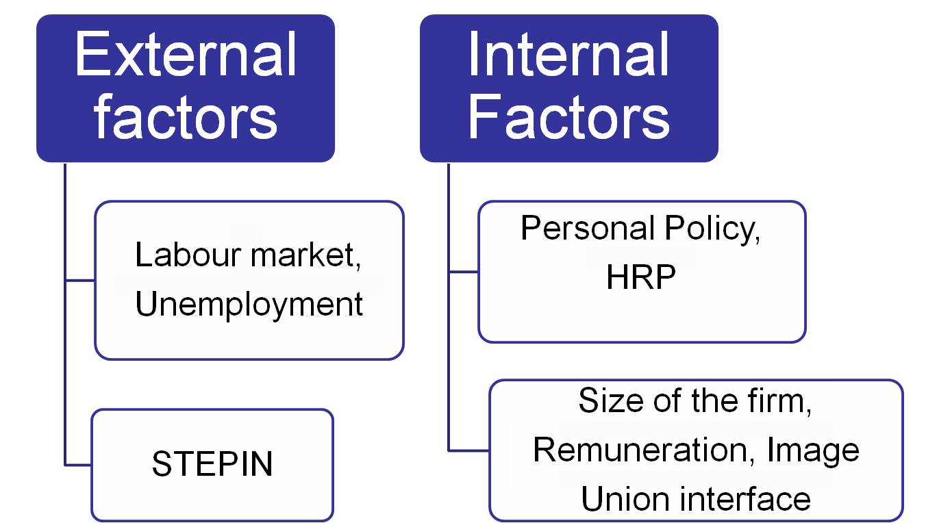
Factors affecting the recruitment Programme

Slide 75
Political Legal Considerations: Recruitment policy must pursue government’s policy regarding reservation of jobs for candidates belonging to various categories SC-ST, OBC, PH etc..

Slide 76
Sons of Soil : Preferences are given to people of their respective states in matters of employment
Image: The company’s image also matters in attracting large no. of job seekers .

Slide 77
Internal factors
Human Resource Planning: A company cannot attract prospective employees in required no. and with required skills overnight.
Size of the firm: An organisation with 1000 employees will find the recruitment easier than with 100 employees

Slide 78
PREREQUISITES FOR GOOD RECUITMENT POLICY
ABIDE BY THE RELEVANT PUBLIC POLICY AND LEGISLATION ON HIRING AND EMPLOYMENT RELATIONSHIP.
PROVIDE EMPLOYEES WITH JOB SECURITY AND CONTINUOUS EMPLOYMENT.
INTEGRATE ORGANISATIONAL NEEDS AND EMPLOYEE NEEDS.
PROVIDE EACH EMPLOYEE WITH FREEDOM AND OPPORTUNITY TO UTILISE AND DEVELOP KNOWLEDGE AND SKILLS TO THE MAXIMUM POSSIBLE EXTENT.
TREAT ALL EMPLOYEES FAIRLY AND EQUITABLY IN ALL EMPLOYMENT RELATIONSHIPS.
PROVIDE SUITABLE JOBS AND PROTECTION TO HANDICAPPED,WOMEN AND MINORITYGROUPS.
ENCOURAGE RESPONSIBLE TRADE UNIONS.
BE FLEXIBLE ENOUGH TO MEET THE CHANGING NEEDS OF THE ORGANISATION.

Slide 79

FRAMEWORK OF RECRUITMENT AND SELECTION
RECRUITMENT ADVERTISEMENT
ORG. GOALS
JOB ANALYSIS
WORKLOAD ANALYSIS & MANPOWER REQUIREMENT
APPLICANTS
JOB DES. & JOB SPEC.
SELECTION PROCESS
APP. FORMS
TESTS
INTERVIEW
REF. CHECKS
MEDICAL EXAM
SELECTED CANDIDATES

Slide 80
Recruitment Process
HRP
Employee requisition
Determination of Strategy
Evaluation of sources of recruitment
Implementation of recruitment methods and strategies
Feedback and Control

Slide 81
Stages of Recruitment Process-
Planning
Strategy development
Searching
Screening
Evaluation and control

Slide 82
Promotions
Employee
Referrals
Transfers
Internal
Recruitment
Sources
Job
Posting
Retired
Employees
Dependants of deceased
employees
Notes:
Amity Business School
8
But where do companies go to recruit employees? Many companies are finding new employees through the Internet. Organizations that are looking for people with a high-level of technological skills may focus their recruitment efforts by using the Internet. The web sites of organizations frequently have a link for enabling the browser to submit a resume.
The source that is used should reflect the labour market, the type or level of position, and the size of the organization.
Are certain recruiting sources better than others? Recent studies have demonstrated that employee referrals generally produce the best candidates. This is because current employees screen applicants before referring them. Second, current employees believe that their reputations with the firm will be reflected in the candidates that they recommend; so, they refer only those who they believe will not make them look bad. Employee referrals, however, may not generate the diversity and mix of employees that is desirable.

Slide 83
Internal Recruiting
Con’s
  Insufficient internal labor supply when in growth mode
  Ripple/domino effect
  Cumbersome procedures to ensure fairness
  Become inbred, lose flexibility
  Constrains organizational agility
Pro’s
  Easier to access candidates
  Motivates employees
  Reduces training and ‘ramp up’ time
  Faster
  Less expensive
  Increases job security

Slide 84
Campus
recruitment
Employment
exchanges
Walk-in
E- recruiting
External
Recruitment
Sources
Outsourcing
Word of mouth
Competitors/
poaching
Advertisements
Notes:
Amity Business School
8
But where do companies go to recruit employees? Many companies are finding new employees through the Internet. Organizations that are looking for people with a high-level of technological skills may focus their recruitment efforts by using the Internet. The web sites of organizations frequently have a link for enabling the browser to submit a resume.
The source that is used should reflect the labour market, the type or level of position, and the size of the organization.
Are certain recruiting sources better than others? Recent studies have demonstrated that employee referrals generally produce the best candidates. This is because current employees screen applicants before referring them. Second, current employees believe that their reputations with the firm will be reflected in the candidates that they recommend; so, they refer only those who they believe will not make them look bad. Employee referrals, however, may not generate the diversity and mix of employees that is desirable.

Slide 85
External Recruiting
Pro’s
  Promotes new ideas, viewpoints, skills
  Increases all forms of diversity
  Save on training if right hires are made
  Allows for rapid growth
  Useful to initiate business turnaround
Con’s
  Expensive
  Can take longer than internal hiring
  Always the risk of hiring someone who is not successful
  Limits internal promotion opportunities
  Can create internal morale problems

Slide 86
Realistic Job
Preview Benefits
Helps ensure that job seekers understand the actual nature of jobs available to them.
Provides job applicants with an opportunity to observe others performing the work.

Slide 87
Selection
Selection is the process of picking individuals (out of the pool of job applicants) with requisite qualifications and competence to fill jobs in the organization.
“ Selection is the process of differentiating between applicants in order to identify and hire those with a greater likelihood of success in a job.”

Slide 88

SELECTION PROCESS
Development Bases for selection
Job Analysis
Application/Resume/CV
HR Plan
Written Examination
Preliminary Interview
Recruitment
Business Games/Tests
Final Interview
Medical Examination
Assess the fit between
the job and the candidate
Reference Checks
Job Offer
REJECTED
APPLICANTS
Placement

Slide 89
Application Blank
Application blank or form is the most common methods used to collect information on various aspects of the applicants’ academic, social, demographic, work elated background and references. It includes-

Slide 90
Selection Strategies
Paper screening
Interviewing
Background investigations

Slide 91
Selection Tests
job seekers who pass the screening and the preliminary interview are called for tests,so as to get information which is not available in application blank.
Personality tests ( like thematic apperception test etc.)
Intelligence tests
Interests tests
Graphology test
Polygraph tests
Medical tests
Drug tests

Slide 92
SELECTION
TESTS
APTITUDE TESTS
***Potential of a
Candidate to learn a
New job or skill,
IQ LEVEL.***
ACHIEVEMENT
TESTS
***What a person can
Do i.e. the skills
And training. The
Person had
Already acquired***.
PERSONALITY
TESTS
***pen & paper test
To judge the
Psychological
Make-up of a
Person i.e. probe
Individual value
System ,maturity .etc.
INTEREST TESTS
***inventories of a
person’s likes and
Dislikes in relation
To work i.e.
Identify the kind of
Work that will
Satisfy him.***

Slide 93
Employment Interview
An interview is a formal in depth conversation between applicant and interviewer/s

Slide 94
TYPES OF INTERVIEWS
Structured Interview : A preset standardized questions
2. Unstructured Interview : is largely unplanned and the interviewee does most of talking.
3. Mixed Interview
4. Behavioral Interview : Evaluation is based on the solution and approach of the applicants.
5. Stressful : A series of harsh, rapid fire questions intended to upset the applicant.

Slide 95
CONT….
INTERVIEWS FORMATS
a) Patterned interview/ structured interview
b) Non Directed/ unstructured interview
c) Mixed interview
d) Exit interview
f) Depth interview
g) Stress interview
h) Formal interview
i) Informal interview
j) Case interview

Slide 96
Types of interview
Screening Interview
Telephone Interview
Video Conferencing
Individual interview (one-on-one interview/ face-to-face interview)
Panel interview
Group interview
General Group Interview/Information Session
Sequential/Serial Interview

Slide 97
Background Investigation
By checking the candidate's past employment, education, personal reputation, Financial condition, police record, etc.
Medicinal Examination
The pre-employment physical examination or medical test of a candidate is an important step in the selection procedure.
Some organizations either place the examination relatively early in the selection procedure or they advise the candidates to get themselves examined by a medical expert so as to avoid disappointment at the end.

Slide 98
CONT…
Final Selection
After a candidate has cleared all the hurdles in the selection procedure, he is formally appointed by issuing him an appointment letter or by concluding with him a service agreement.

Slide 99
EXAMPLES-
REEBOK- REEBOK’s idea for ideal manager is simple: someone who can think young. Director(HR) “we need youth, vitality, openness, a zest for life.

Slide 100
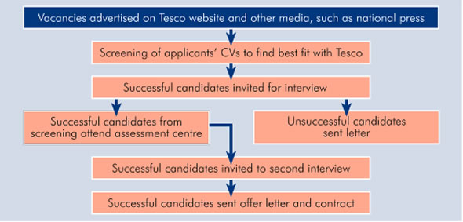
Tesco

Slide 101
Confirming the Selection/Reference checks
Names, addresses and contact nos. of references for the purpose of verification and gaining additional information of the applicants are obtained. Referees can be : known public figures, previous employers, professors etc.
Formal references
Informal, network references and contacts
Criminal background investigation (Criminal Offender Record Investigation)
Physical examination
Verify credentials (degrees, licenses, etc.)

Slide 102
Physical Examination
Certain jobs require unusual stamina, strength and tolerance of hard working conditions.
Candidate has to undergo Physical fitness test done by company’s physician or approved medical officers

Slide 103
The Job Offer
Finally selection decision must be made..after getting information from the preceding steps and decision has to be made in consideration with the line managers(dept. heads) as they are responsible for the performance of the employees.
Salary considerations:
  Market requirements for skill level
  Internal market considerations
Clarify probationary period and consequences of failure

Slide 104
PROMOTION

Slide 105
Definition
Advancement within an organisation is labelled as promotion
In simpler terms, promotion refers to upward movement in present job leading to greater responsibilities, higher status and better salary.
Promotion may be temporary or permanent depending upon the organizational requirement.
Promotion is the ultimate motivating factor for any employee.

Slide 106
Types of promotion
On the basis of the factors involved in promotion it can be classified into three forms
Horizontal promotion
Vertical promotion
Dry promotion

Slide 107
Horizontal promotion
Employee’s job classification remains the same but increase in responsibilities.
Ex: Lower division clerk may be promoted to upper division Clerk with same job assignment and responsibility
Vertical Promotion:
An employee crosses his job .This increases his responsibility, status, prestige and pay, together with a change in the nature of the job.
Ex- from Computer Operator to Assistant Administrator Office
Dry promotions :
it refers to an increase in responsibility and status without the increase in pay.
Ex-when an university professor is made Head of the Department, there is no increase in salary.

Slide 108
Needs and advantages of Promotion
Need for promotion
it is to emphasised that the organisation should have proper and systematic promotion policy
Organisation needs : no organisation can rely on outside recruitment to fill all its requirements
Providing motivation: promotion possibilities influence the behaviour of individuals in the organisation
Proving satisfaction : modern organisations provide numerous benefits to their members
Advantages of promotion
recognize employee’s performance and commitment and
motivate him towards better performance;

Slide 109
develop competitive spirit among employees for acquiring knowledge and skills for higher level jobs;
retain skilled and talented employees;
reduce discontent and unrest;
To fill up job's vacant position that is created due to retirement, resignation or demise of an employee.In this case next senior employee will be promoted to the vacant job.
utilize more effectively the knowledge and skills of employees; and
attract suitable and competent employees.

Slide 110
Basis of Promotion
Promotion is given on the basis of seniority or merit or a combination of both. Let us discuss each one as a basis of promotion.
Seniority as a basis
It implies relative length of service in the same organization. The advantages of this are: relatively easy to measure, simple to understand and operate, reduces labour turnover and provides sense of satisfaction to senior employees. It has also certain disadvantages: beyond a certain age a person may not learn, performance and potential of an employee is not recognized, it kills ambition and zeal to improve performance.
Merit as a basis
Merit implies the knowledge, skills and performance record of an employee. The advantages are: motivates competent employees to work hard, helps to maintain efficiency by recognizing talent and performance. It also suffers from certain disadvantages like: difficulty in judging merit, merit indicates past achievement, may not denote future potential and old employees feel insecure

Slide 111
Seniority-cum-Merit as basis:
As both seniority and merit as basis suffer from certain limitations, therefore, a sound promotion policy should be based on a combination of both seniority and merit. A proper balance between the two can be maintained by different ways: minimum length of service may be prescribed, relative weight age may be assigned to seniority and merit and employees with a minimum performance record and qualifications are treated eligible for promotion, seniority is used to choose from the eligible candidates.

Slide 112
Promotion Program and Procedure
Every organization should make advance plans for promotion programme. A carefully planned promotion programme has four elements:
a) formulation of promotion policy,
b) identification of promotion channels,
c) promotion appraisal
d) centralized records.

Slide 113
a) Formulation of Promotion Policy:
Each organization needs to maintain a balance between the internal sources of personnel promotion and external sources by means of recruitment. Hence, promotion must be based on consistent, fair and clear cut policy
b) Promotion Channels:
Promotion channels should be identified and recorded on paper. This process is related with job analysis and career planning of an organization.
c) Promotion Appraisals:
The promotion of an employee is entirely dependent upon his/her performance appraisal outcome.
d) Centralised Records:
The education, experience, skills, abilities and evaluation of all employees should be recorded and maintained in a centralised manner by the department of the organization, because basing on these attributes, promotion is given to an employee

